Slide 1
Generative Adversarial Networks
Deep Learning CA 2 – Part A
Terry Boo Chee Yee (P2211194) | Li Sheng (P2309110)
DAAA/FT/2B/22

Slide 2
Table of contents
01
05
02
06
03
07
04
08
Background
Evaluation Metrics
Exploratory Data Analysis
Modelling
Data Cleaning
Final Model
Data Preprocessing
Conclusion

Slide 3
01
Background

Slide 4
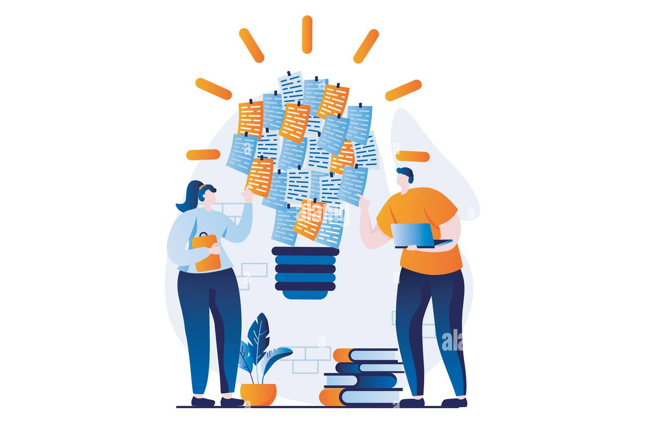
Task & Solution
Task
In our project, we aim to create 260 small black-and-white images of handwritten letters using the EMNIST Letters dataset. This task involves several key steps, including data cleaning, feature engineering, model selection, training the GAN, fine-tuning the GAN, evaluation, and image generation.
Solution
In our project, we will explore various types of Generative Adversarial Networks (GANs) to generate 260 small black-and-white images of handwritten letters from the EMNIST Letters dataset. Each GAN variant comes with its own advantages and disadvantages, which we will weigh to determine the best-performing model for our task.
Alexdndz, no date

Slide 5
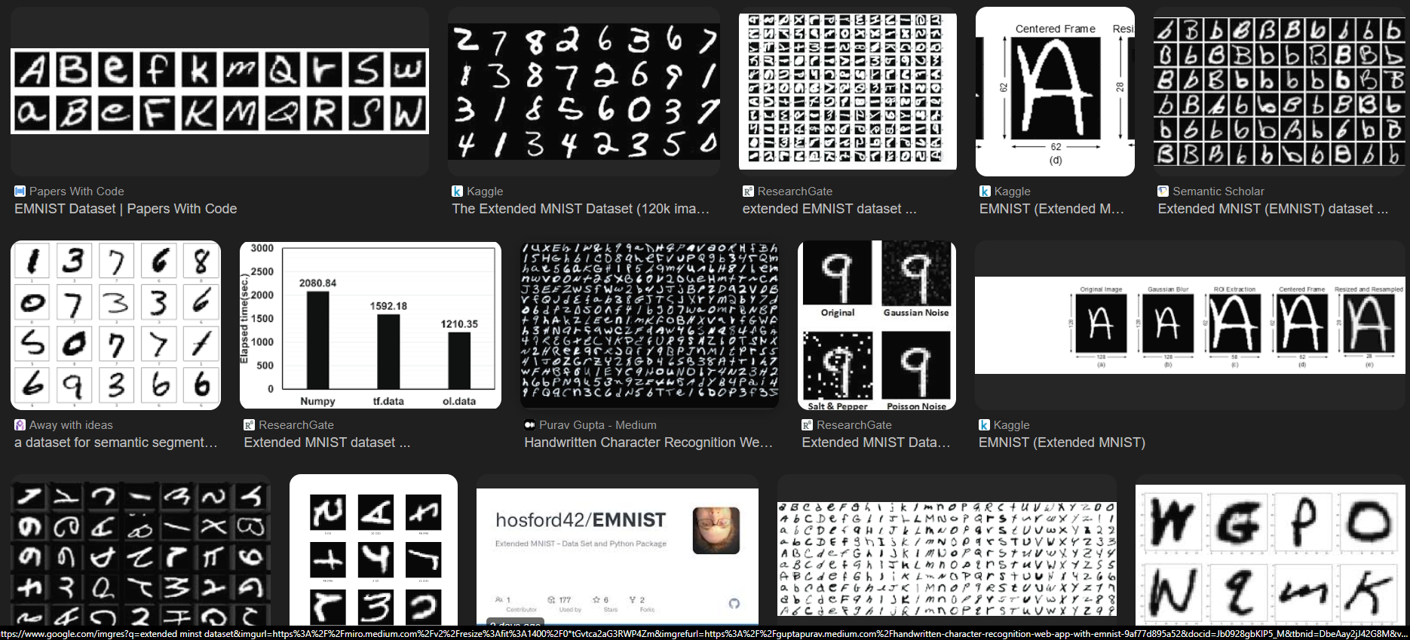
About the Dataset
The EMNIST Letters dataset contains 26 classes, corresponding to the 26 letters of the English alphabet (A-Z).
Similar to the MNIST dataset, the images in EMNIST are grayscale and of size 28x28 pixels. Each pixel value is an integer between 0 and 255, where 0 represents a black pixel and 255 represents a white pixel.
The labels for the images are numeric values from 1 to 26, corresponding to the letters A-Z.
Google search on EMNIST dataset

Slide 6
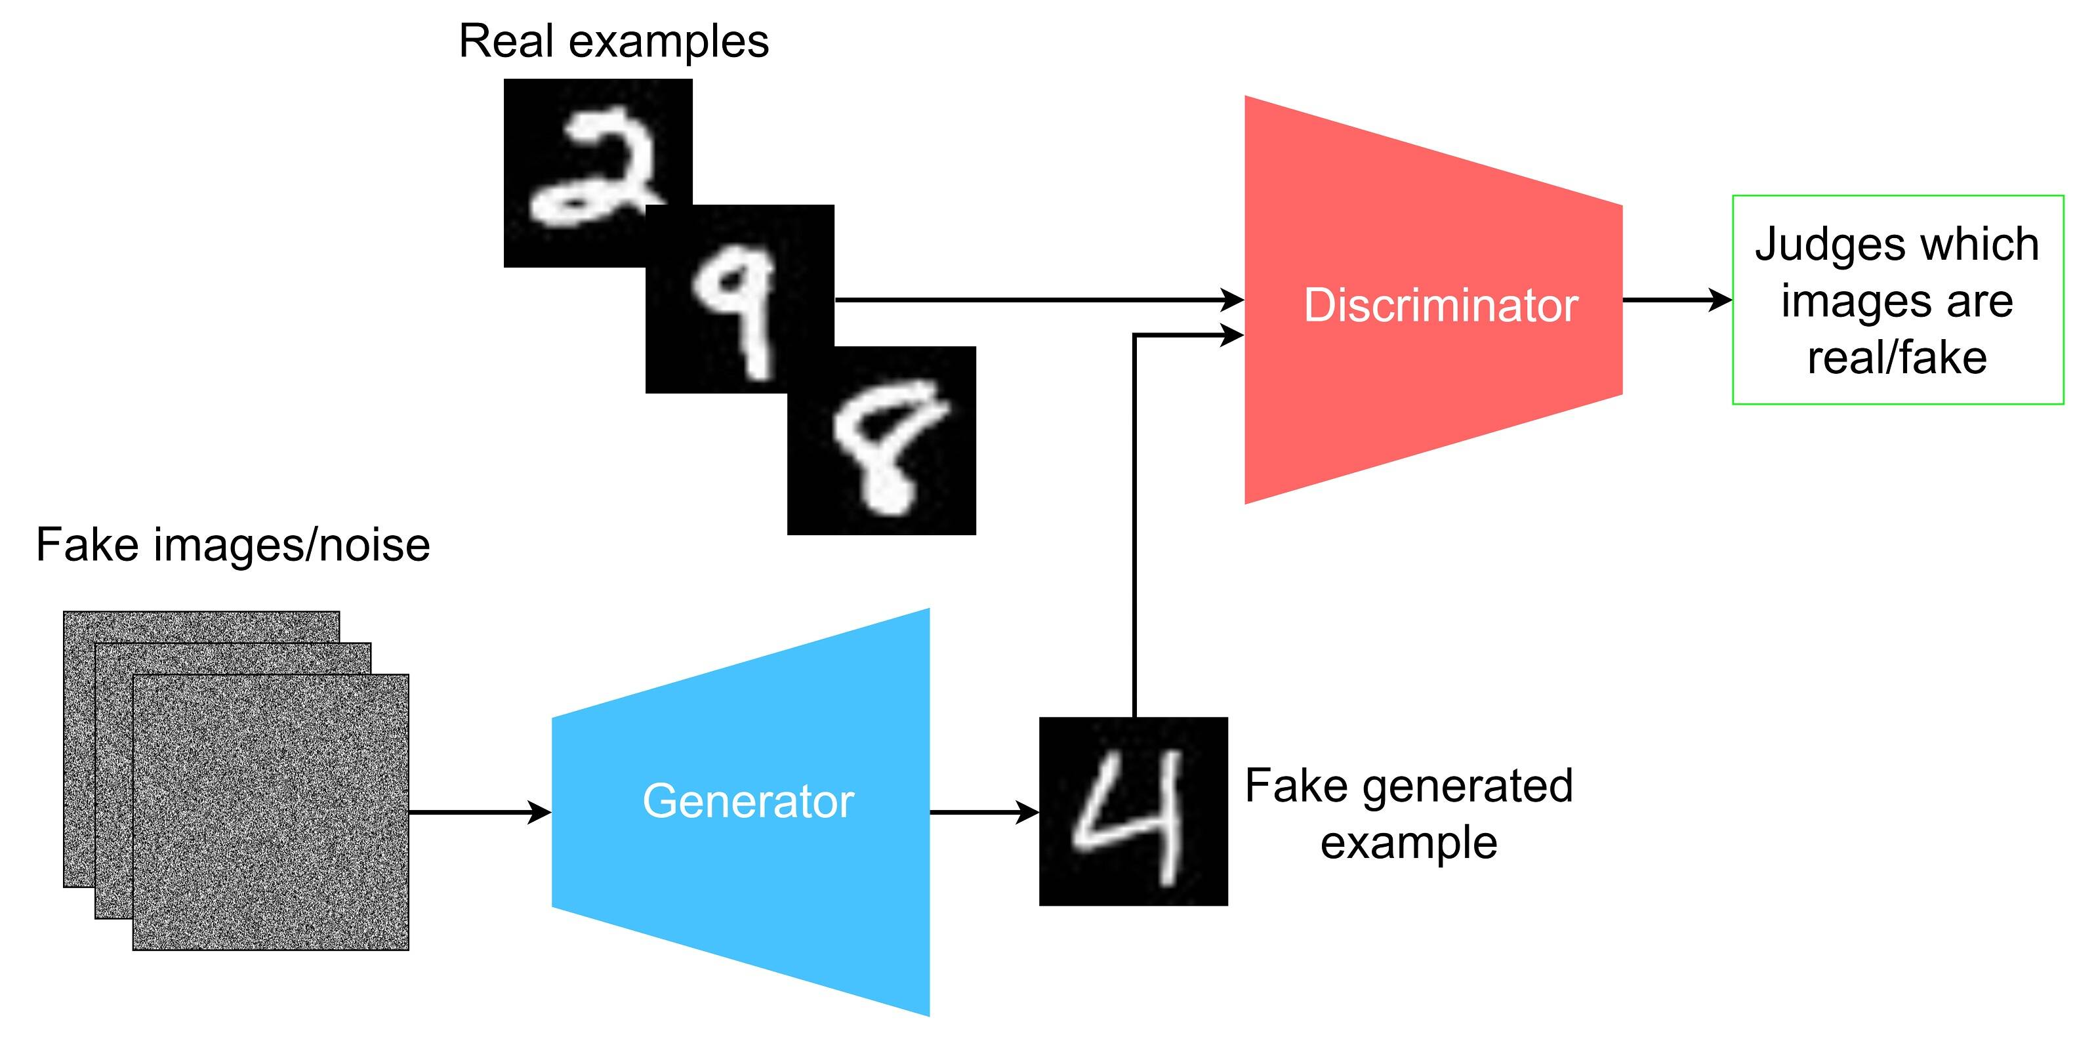
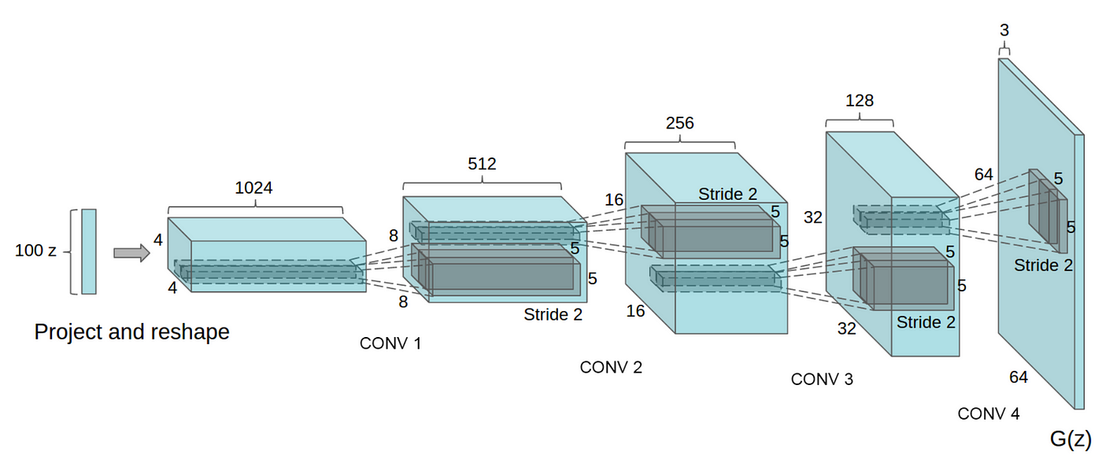
What are GANs
What are GANs
Generative modelling is an unsupervised learning task in machine learning that involves automatically discovering and learning the regularities or patterns in input data in such a way that the model can be used to generate or output new examples that plausibly could have been drawn from the original dataset.
How Gan works
Discriminator: The discriminator in a GAN is simply a classifier. It tries to distinguish real data from the data created by the generator. It could use any network architecture appropriate to the type of data it's classifying.
Generator: The generator part of a GAN learns to create fake data by incorporating feedback from the discriminator. It learns to make the discriminator classify its output as real.
First, the generator creates samples from random noise inputs and feeds these generated samples into the discriminator. The discriminator then tries to classify whether each sample is real (from the actual data distribution) or generated (fake).
Components in a GAN model (Hansen, 2022)
Stacking conv layers (Chablani, 2017)

Slide 7
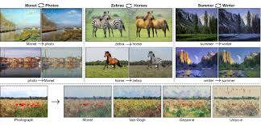
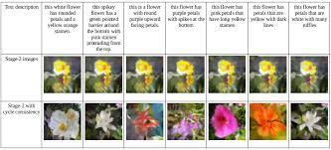
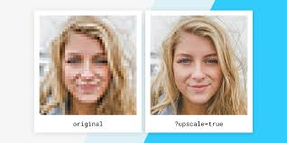
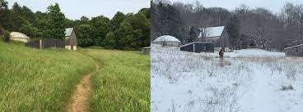
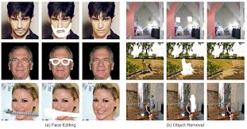
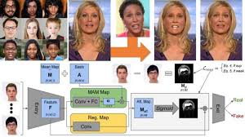
Applications of GAN
Image-to-Image Translation
GANs can translate images from one domain to another, such as converting sketches to realistic images, day images to night images, and black-and-white images to color images. This has applications in fields like computer graphics and virtual reality.
Text-to-Image Translation
GANs (Generative Adversarial Networks) are increasingly used in text-to-image translation, where they generate detailed and contextually accurate images based on textual descriptions. This technology is particularly useful in creative industries, allowing artists and designers to visualize concepts from textual input.
Super Resolution
Super Resolution Generative Adversarial Networks (SRGANs) are highly effective in enhancing the resolution of images, significantly increasing their clarity and detail. This can be particularly useful in several areas, such as improving the resolution of medical scans for better diagnosis, enhancing the quality of surveillance footage for clearer identification, and improving satellite images for more detailed geographical and environmental analysis.
Photograph Editing
GANs are widely utilized in photograph editing to enhance and transform images through various innovative tasks. For instance, they can effectively replace the background of a photograph with an entirely different scene, making it easier to create composites or adjust the context of an image. Additionally, GANs can change facial attributes, allowing for modifications such as altering expressions, changing hairstyles, or even aging or de-aging subjects. Furthermore, they enable the modification of specific attributes of objects within photos, such as changing the color of a car, altering the texture of a building, or modifying clothing in fashion images.
Photo Inpainting
GANs (Generative Adversarial Networks) are employed in photo inpainting to restore missing parts of an image or remove unwanted objects by generating content that seamlessly blends with the surrounding areas. They are particularly effective in filling gaps in damaged photographs, removing unwanted elements, and reconstructing incomplete parts of images.
Deep Fake
GANs are a key technology in the creation of deepfakes, which are realistic audio and video forgeries. By leveraging the capabilities of GANs, creators can generate highly convincing synthetic media that can swap faces in videos, create realistic lip-syncing, or even simulate a person's voice. In entertainment, deepfakes can be used for special effects in films, allowing for seamless integration of actors into various scenes without extensive makeup or CGI.

Slide 8
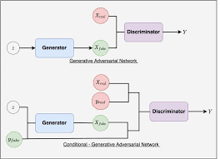
If you are asked to generate images of a specific class, propose a way of doing it
We can use Conditional GAN (CGAN). Conditional GANs are an extension of standard GANs and consist of two main components: the generator and the discriminator. Unlike a typical DCGAN, where the generator only takes in a noise vector (random input) and the discriminator only determines whether the image is real or generated, the generator in CGANs takes both a noise vector and a class label as inputs to generate an image corresponding to the specified class. Similarly, the discriminator takes both an image and a class label as inputs to determine whether the image is real (from the dataset) or generated (by the generator).
During the training process of a CGAN, a noise vector and a class label are fed into the generator to produce a synthetic image corresponding to the given class. Real images from the dataset, paired with their class labels, are then combined with the generated images and labels. The discriminator is trained on this mixed set, learning to distinguish between real and generated images. This process involves calculating the loss for both real and fake images and updating the discriminator's weights accordingly. After training the discriminator, the generator is trained to fool the discriminator by generating images that appear real. This is done by freezing the discriminator's weights and updating the generator's weights based on the discriminator's feedback. The generator's loss is calculated based on how well it can generate images that the discriminator classifies as real. This cycle continues for many iterations, gradually improving both the generator's ability to produce realistic images and the discriminator's ability to distinguish real from fake images, with the added conditional element allowing for class-specific image generation.
In conclusion, CGANs are trained on additional infomation such as class labels, thus allowing them to generate images based on specific classes.
Components in a GAN model (TankUs, 2023)

Slide 9
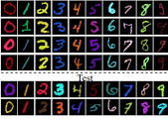
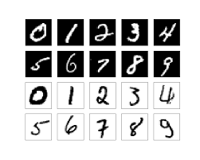
If you are asked to generate coloured images instead of black-and-white ones, do you think it would be easier or harder to produce better quality results
It would be harder to produce better quality of coloured images.
Coloured images have three channels (Red, Green, and Blue) compared to the single channel in black-and-white images. This increase in dimensionality means the model has to learn more detailed and complex patterns.
The complexity of colored images can exacerbate training instability, making it harder to achieve convergence and maintain consistent performance.
The increased complexity in the images means increased computational requirements, which can lead to longer training times and a need for more powerful hardware.
Accurately representing how light interacts with colored surfaces is more complex compared to black-and-white images. Colored images require the model to handle reflections, shadows, and color bleeding effects, which add layers of complexity that are not present in black-and-white images, where light interactions are simpler and often rely on shades of gray.
Colored vs black and white MNIST

Slide 10
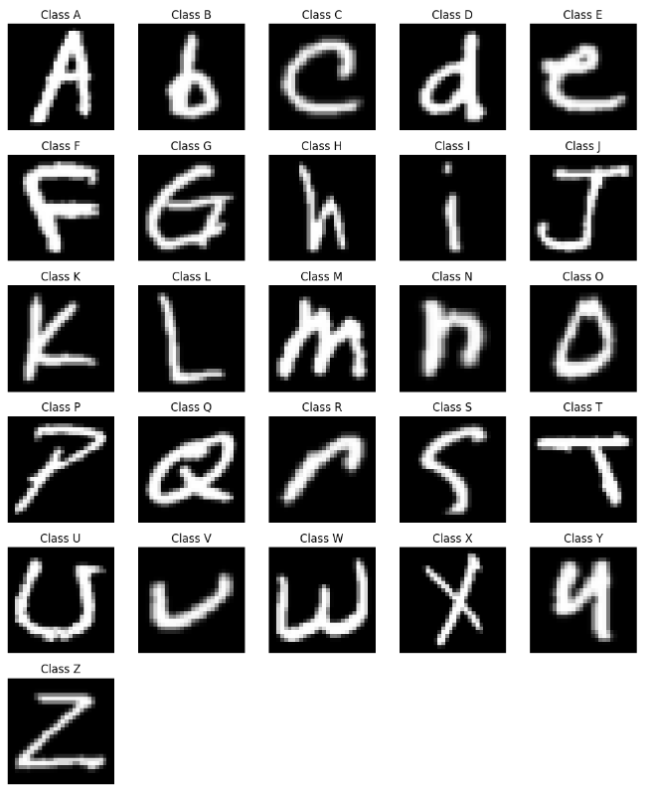
What class(es) is/are relatively easier/harder to generate? Why?
Classes that are relatively easier to generate
Straightforward (e.g., "I", "L", "O")
These letters have simpler shapes and fewer strokes, making them less complex for the GAN to learn. Additionally, they typically have more consistent representations in handwriting, reducing variability.
Letters where lowercase and uppercase forms are similar (e.g., "C", "O", "V", "K", "P", "U")
Letters in which uppercase and lowercase forms maintain the same basic shape, with size as the primary difference, allow the GAN to learn a consistent representation without needing to adapt to drastically different forms. The minimal structural differences also result in fewer variations in how these letters can be written, reducing the complexity the GAN must manage.
Classes that are relatively harder to generate
Complex Letters (e.g., "S", "G", "Q")
These letters often have more intricate curves and loops, which can introduce greater variability in styles and representations. The added complexity can challenge the GAN's ability to generate accurate samples.
Letters with variability in different handwriting styles (e.g., "A")
The same letter can look very different depending on individual writing styles, leading to variations in structure and positioning. When a letter can have multiple forms, the GAN must learn to generate a wider range of structures and styles. This complexity requires the model to capture more nuanced features, which can be challenging.
All classes in the Dataset

Slide 11
02
Exploratory Data Analysis

Slide 12
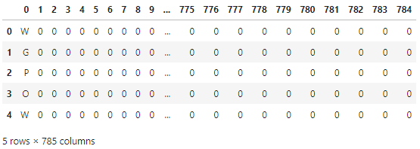
About the dataset
EMNIST Dataset
This dataset comprises 99,040 images with 785 columns, where the first column represents the class label, and the subsequent columns contain pixel values.
Identify Images with Uniform Pixel Values
Images with uniform pixel values are those where all the pixel values are the same across the entire image.
Uniform pixel values result in an image that is a single, solid colour with no variation or detail, which may not provide any useful information for analysis or training.
The dataset includes 10,240 images with uniform pixel values, all categorized under the '-1' class.

Slide 13
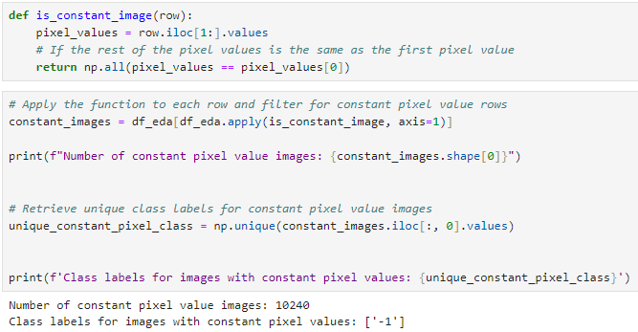
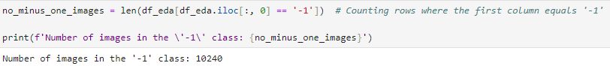
Identify Images with Constant Pixel Values
What are constant pixel values
Constant pixel values, when referred to in the context of an entire image, mean that every pixel in the image has the same value. This results in a completely uniform image without any variation in colour or intensity.
Results
The dataset includes 10,240 images with uniform pixel values, all categorized under the '-1' class.
Since there are 10,240 images in the '-1' class, all the images in the '-1' class are images with uniform pixel values
We will take note of the images with uniform pixel values during the Data Cleaning process

Slide 14
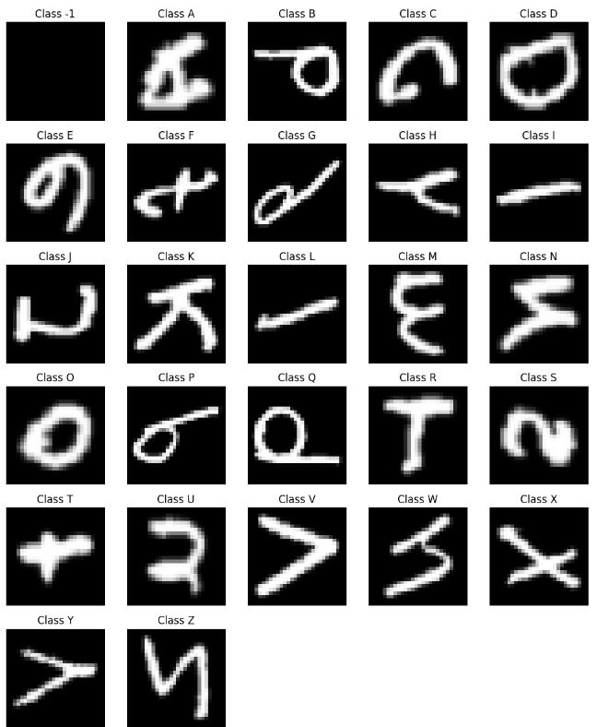
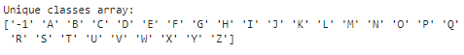
Unique Classes in the Dataset
The Dataset contains images of A - Z class and there is a '-1' class.
Looks like the images are representing their labels correctly, but they are not oriented in an upright position. In addition, the '-1' class contains images of solid colours.

Slide 15
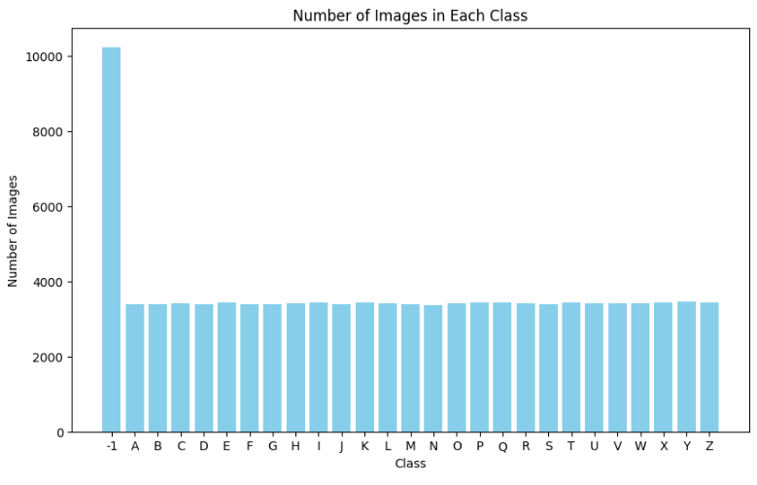
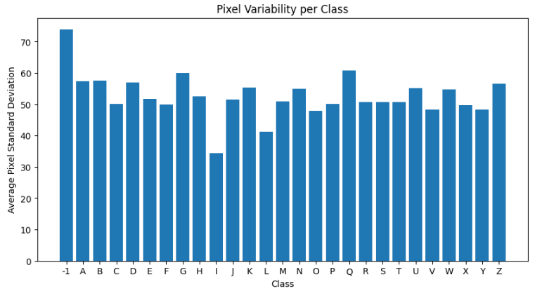
Number of Images & Pixel Variability in each class
Number of Images
There are approximately 10,000 images in the '-1' class, whereas the other classes each have around 3,700 images.
Pixel Variability
Variations in pixel standard deviation could reflect differences in how the features of each class are represented. For example, certain letters may have more diverse writing styles leading to higher pixel variability.
Classes with significantly lower or higher pixel variability (e.g., 'Q', 'G', and '-1') might be outliers. This can indicate either unique features within those classes or potential issues with data quality or labelling.
Results
The '-1' class exhibits the highest pixel variability, whereas the 'I' class shows the least variability.
We don't need to be concerned about pixel variability because we will normalize the images during the Feature Engineering step. Normalization will ensure that the pixel values are scaled properly for training.

Slide 16
03
Data Cleaning

Slide 17
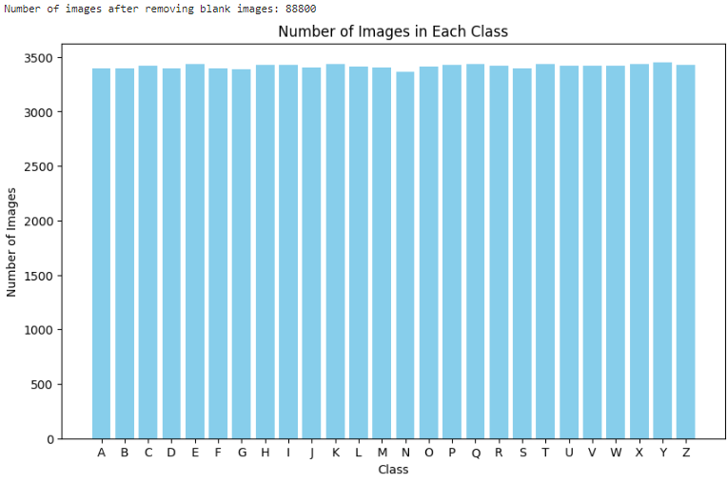
Excluding Images with Constant Pixel Values
Why do we exclude images with constant pixel values
Images with constant pixel values lack variability and do not provide any meaningful features or patterns that can be used for training models. They do not contribute to learning useful representations.
Including such images can reduce the efficiency of training processes. The model might spend unnecessary computation cycles processing these uninformative images, which can slow down the overall training process.
In datasets where variability is crucial (e.g., object detection, classification, or segmentation), constant pixel value images act as noise. They do not help in learning the distribution of the target data and can lead to suboptimal performance.
Steps:
Dropped the constant pixel value images
Total number of images 99,040 -> 88,800
The number of images in each class is now relatively balanced with a few variability within each class.

Slide 18
04
Data Preprocessing

Slide 19
Flipping the images upright
What we realised
We have realised that the images are flipped vertically and are rotated 90 degree anti clockwise
Why do we have to flip the images upright
GANs generate images based on learned patterns from the training data. If the images are flipped or rotated, the model will learn incorrect associations, leading to unrealistic outputs (Images generated will not be upright too).
What will we do to flip the images upright
We will first flip the images vertically and next rotate the images 90 degrees clockwise

Slide 20
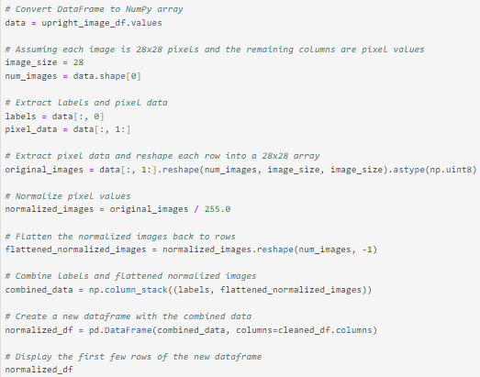
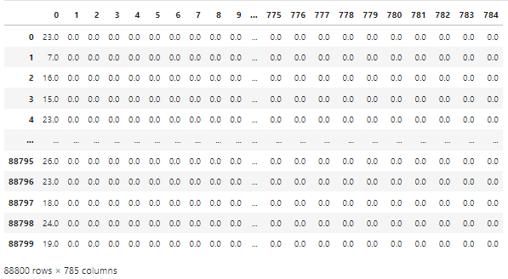
Normalizing the Images
What is Normalizing the Images
Normalizing images refers to the process of adjusting the pixel values of the images to a common scale such as [0, 1] or [-1, 1].
Why did we normalize the images
Normalization helps standardize the pixel values, allowing the GAN to learn patterns more effectively.
Normalized inputs can lead to more stable training, reducing issues like vanishing or exploding gradients.
Normalization prevents the model from being overly influenced by the absolute values of pixel intensities, helping it focus on the relative features of the images.
What we did
We have normalized the images to a [0, 1] scale

Slide 21
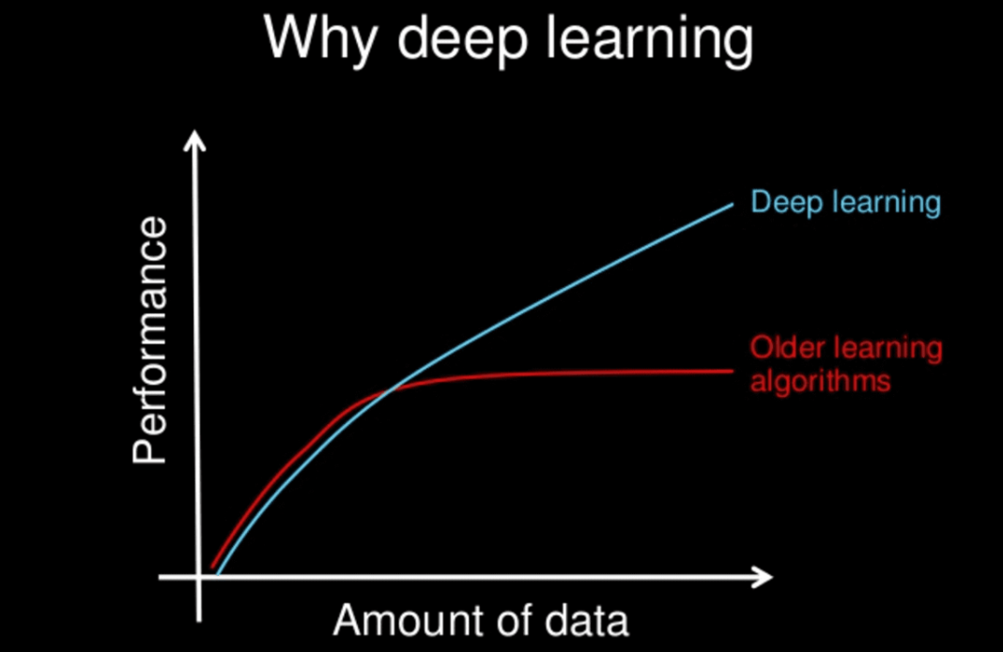
Data Augmentation
What is data augmentation
Data augmentation is a technique used to artificially increase the size of a training dataset by applying various transformations to the existing data samples. These transformations include rotations, translations, flips, changes in brightness and contrast, cropping, and more. This diversify the training data and expose the model to a wider range of variations.
Why did we augment the dataset
Data augmentation introduces variations in the training images, allowing the GAN to learn more robust features and reducing the risk of overfitting. Additionally, augmented images make the GAN more resilient to variations in input, such as changes in orientation and scale. By exposing the GAN to various transformations, it can learn to generate more diverse and realistic images, ultimately improving the quality of its outputs.
Steps taken to augment the data
Resample the train dataset and put the resampled images into a Data Frame
Define an Image Data Generator to Augment the data
Augment the data
Combine the augmented data with the original train dataset
Andrew Ng, 2019

Slide 22
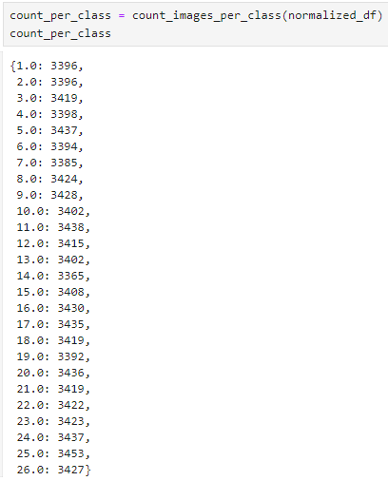
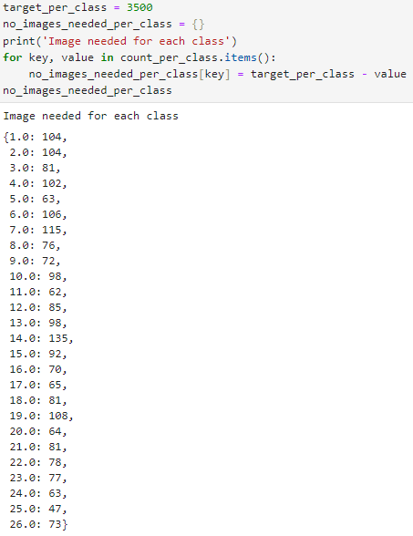
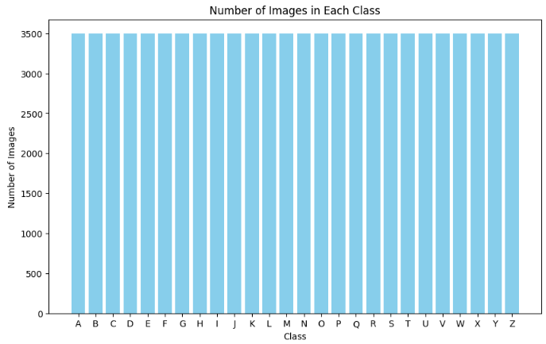
Data Augmentation
Target
To handle class imbalance in normalized_df we augment the dataset to achieve a target number of images per class (target_per_class = 3500).
Number of images in each class
Number of images needed for each class

Slide 23
05
Evaluation Metrics

Slide 24
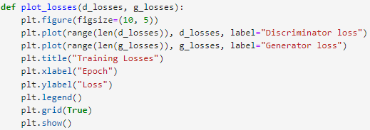
Loss (Generator Loss and Discriminator Loss)
Generator Loss
The generator loss measures how well the generator is performing in producing realistic images that can fool the discriminator. It is calculated based on the discriminator's feedback for the images generated by the generator. The goal of the generator is to minimize this loss, which means it aims to improve its ability to create images that the discriminator classifies as real.
Discriminator Loss
The discriminator loss evaluates how effectively the discriminator can distinguish between real and generated images. It is calculated by measuring the discriminator's accuracy in classifying real images from the training dataset as real (label 1) and the generated images as fake (label 0). The discriminator aims to minimize this loss, enhancing its ability to accurately differentiate between real and generated images.
Optimal Values
For optimal performance, both losses should be balanced. If the generator loss is significantly lower than the discriminator loss, it suggests that the generator is dominating the training, while if the discriminator loss is very low, it may indicate that the generator is struggling to produce convincing images.

Slide 25
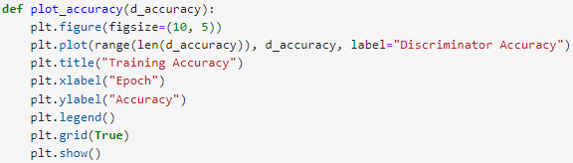
Accuracy (Discriminator Accuracy)
What discriminator accuracy measures
Discriminator accuracy reflects the model's ability to correctly identify real images as real (label 1) and generated images as fake (label 0).
Balance in Training
Ideally, the discriminator's accuracy should fluctuate during training. This fluctuation indicates that the generator is effectively challenging the discriminator, contributing to a balanced training process where both components of the GAN improve.

Slide 26
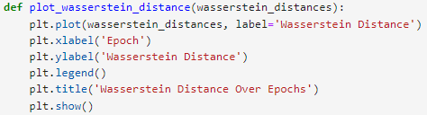
Wasserstein Distances
What is Wasserstein Distances
Wasserstein distance, also known as Earth Mover's Distance (EMD), is a measure of the distance between two probability distributions. It quantifies how much "work" is needed to transform one distribution into another, considering the distribution's underlying geometry.
What is Wasserstein Distances used for
Wasserstein GANs (WGANs) represent an improvement over traditional GANs by utilizing Wasserstein distance as their loss function, which enhances the stability of the training process. This approach effectively addresses common challenges faced in GAN training, such as mode collapse, where the generator produces a limited variety of outputs, and the vanishing gradient problem, which can hinder the learning of the generator and discriminator.

Slide 27
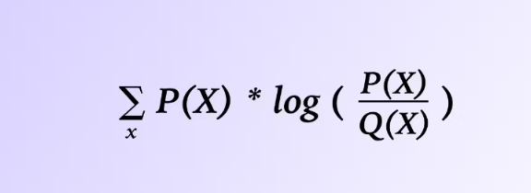
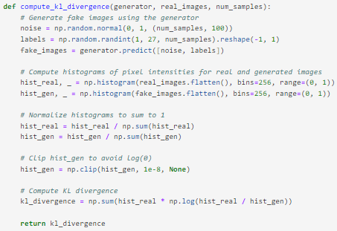
Kullback-Leibler (KL) Divergence
What is KL Divergence
Kullback-Leibler divergence metric (relative entropy) is a statistical measurement from information theory that is commonly used to quantify the difference between one probability distribution from a reference probability distribution.
The divergence between two probability distributions quantifies how much the two differ from each other.
How is KL Divergence used to evaluate GANs
GANs aim to generate samples that resemble the true data distribution. KL divergence can quantify how well the distribution of generated samples matches the distribution of real data.
By comparing the distributions of generated and real samples, we can compute KL divergence to assess the fidelity and diversity of the generated samples.
What is 'Good' Value for Kullback-Leibler (KL) Divergence
KL divergence is a measure of difference between distributions and does not have a standardized scale. The value of KL divergence depends on the specific distributions being compared and their variability.
Typically, in GANs, the goal of the generator is to minimize the KL divergence between the distribution of generated samples and the distribution of real data. A lower KL divergence indicates that the generator is producing samples that closely match the real data distribution in terms of statistical properties. Therefore, from this perspective, a lower value of KL divergence is considered better.
Formula for KL Divergence

Slide 28
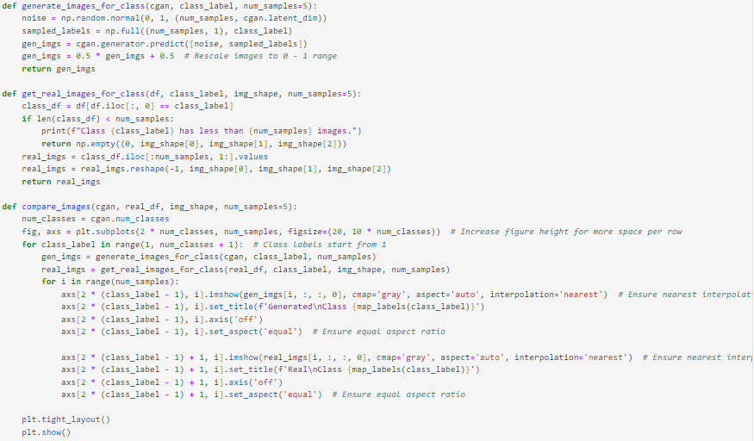
Samples of Generated Images VS Real Images
What will we be doing
To compare real and generated images side by side, we place samples from both datasets next to each other to assess how closely they resemble each other visually, their overall quality, and how well they capture the characteristics of the original data distribution.
Criterias
Evaluate how clear and detailed the images are. Real images typically have sharp details, and generated images should strive to match this quality.
Look for any distortions, blurriness, or unnatural patterns in the generated images that are not present in real images.
Look for diversity among generated images. A good generator should produce a variety of images that cover different aspects of the data distribution, rather than repeating a few similar patterns

Slide 29
06
Modelling

Slide 30
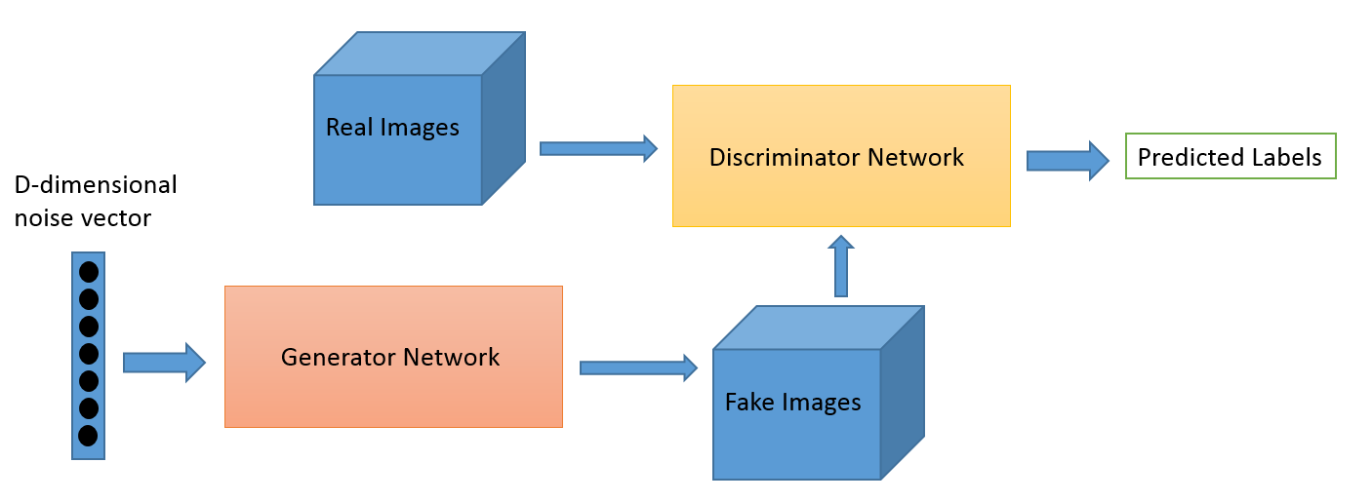
Deep Convolutional GAN (DCGAN)
How Deep Convolutional GAN Works
The generator starts with a random noise vector, typically sampled from a Gaussian or uniform distribution. This noise vector is fed through a series of deconvolutional (transposed convolutional) layers, which progressively upsample and refine it into a realistic image. The goal of the generator is to produce images that are indistinguishable from real ones.
On the other hand, the discriminator takes an image as input, which can either be a real image from the training dataset or a fake image generated by the generator. This image is processed through a series of convolutional layers that downsample it and extract key features, helping the discriminator learn to distinguish between real and fake images. The discriminator outputs a probability score indicating whether the image is real or fake.
The Training Process of Deep Convolutional GAN
First, real images are fed into the discriminator, and its weights are updated to maximize the probability of correctly identifying them as real. Next, generated images are fed into the discriminator, and its weights are updated to minimize the probability of incorrectly identifying them as real. This ensures the discriminator becomes better at distinguishing real images from generated ones.
After updating the discriminator, the generator is trained. During this step, the discriminator's weights are typically frozen to prevent them from being updated based on the generator's training. The generator's loss is calculated based on the discriminator's feedback, specifically aiming to minimize the probability of the discriminator correctly identifying generated images as fake.

Slide 31
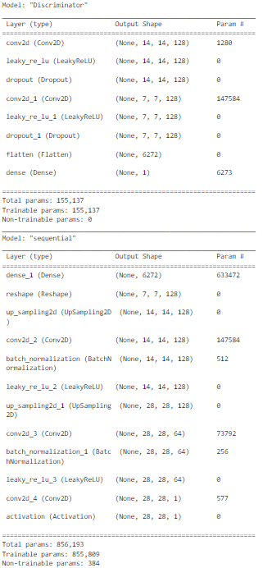
DCGAN (Base)
Main Components of Deep Convolutional GAN (base)
Generator Network
Input Layer: The input layer accepts a noise vector (latent space) typically sampled from a normal distribution.
Dense Layer: The dense layer transforms the noise vector into a higher-dimensional space
Reshape Layer: The reshape layer reshapes the dense layer output into a 3D tensor (height, width, channels)
Upsampling Layer: The upsampling layer increase the spatial dimensions of the input tensor (height and width) while keeping the number of channels the same
Convolutional Layer: The convolutional layer apply convolutional filters to the upsampled tensor to generate feature maps. These layers help in refining the upsampled image and adding more details
Batch Normalization Layer: The batch normalization layer normalize the outputs of the convolutional layers to improve training stability and performance
Activation Functions: Activation functions introduce non-linearity to the network, allowing it to learn more complex patterns
Discriminator Network
Convolutional Layer: The convolutional layer extract features from the input image. Each filter within the layer learns to detect specific patterns or features, such as edges, textures, shapes, or more complex structures, by convolving with the input data. Ultimately it converts the image into numerical values, allowing the neural network to interpret and extract relevant patterns
Leaky ReLU Activation: The leaky ReLU activation introduce non-linearity into the network, allowing it to learn more complex patterns. The Leaky ReLU helps prevent the dying ReLU problem by allowing a small gradient when the unit is not active.
Dropout Layer: The dropout layer prevent overfitting by randomly setting a fraction of input units to 0 during training. This forces the network to learn more robust features.
Flatten Layer: Convert the 3D tensor output from the convolutional layers into a 1D vector, which can be fed into a dense layer
Dense Layer (Output): Perform the final classification by producing a single scalar output. This output is passed through a sigmoid activation function to produce a probability

Slide 32
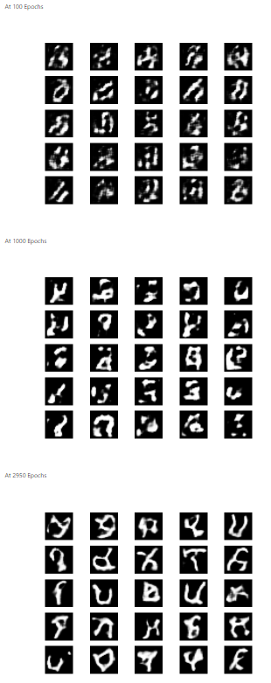
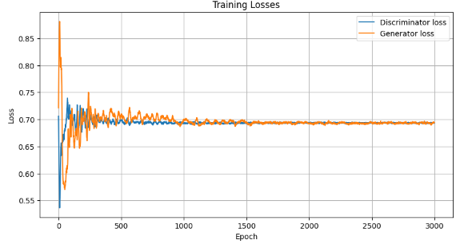
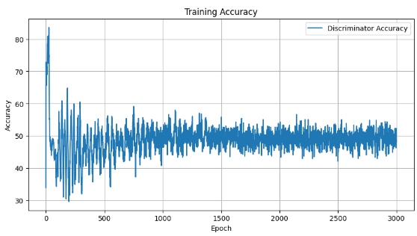
DCGAN (Base)
Base Evaluation

Slide 33
DCGAN (Improving Discriminator)
What is the impact of the discriminator in GANs
The discriminator evaluates whether an image is real (from the training dataset) or fake (generated by the generator). This assessment helps ensure that the generator produces more realistic outputs over time.
The discriminator's performance directly influences the training dynamics of the GAN. A strong discriminator can effectively guide the generator to improve, while a weak discriminator may lead to mode collapse, where the generator produces limited variations of images.
A well-balanced discriminator can help stabilize the training process. If the discriminator is too strong compared to the generator, it may lead to vanishing gradients, making it difficult for the generator to learn. Conversely, if the generator outperforms the discriminator, the latter may not provide useful feedback.
What changed from the previous model
1 additional conv2D layer for the discriminator
1 additional dense layer after the flatten layer for the discriminator
Why did we choose to improve the discriminator
From the baseline model, it is evident that the GAN is not generating images effectively. While some letters are partially represented, many others are not recognizable at all. To address this issue, we decided to enhance the discriminator. By strengthening the discriminator's ability to differentiate between real and generated images, we aim to provide more precise feedback to the generator. This improved feedback will help the generator refine its outputs and create more realistic and diverse representations of handwritten letters. Ultimately, our goal is to achieve higher-quality image generation, ensuring that each letter is accurately represented in the final dataset.

Slide 34
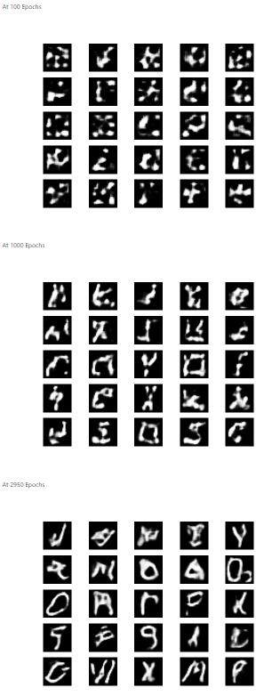
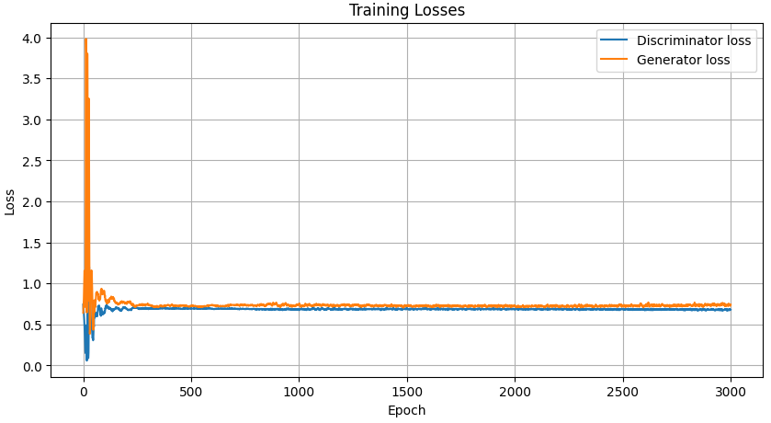
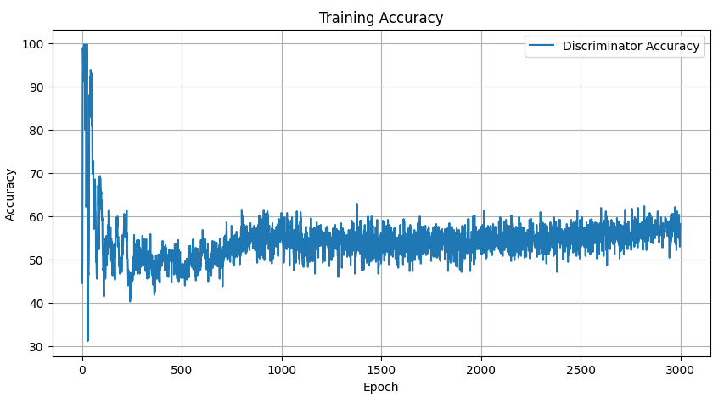
DCGAN (Improving Discriminator)
Improving Discriminator Evaluation

Slide 35
DCGAN (Using ReLU)
What is ReLU activation function
The ReLU (Rectified Linear Unit) activation function is a popular non-linear activation function used in neural networks, particularly in deep learning models. The output of ReLU is zero for any negative input and equal to the input for positive values. This results in outputs ranging from 0 to infinity.
ReLU introduces non-linearity into the model, allowing the generator to learn complex mappings from the latent space to the image space. This is essential for generating high-quality, realistic images.
ReLU's output is zero for negative inputs, leading to sparse activations. This sparsity can improve model performance and reduce the risk of overfitting by encouraging the generator to focus on the most relevant features.
What changed from the previous model
Generator's activation function is changed from Leaky ReLU to ReLU
Difference between ReLU can Leaky ReLU
ReLU and Leaky ReLU differ in several key aspects for the generator in a GAN. ReLU outputs zero for negative values, while Leaky ReLU provides a small, non-zero output for negative inputs. In terms of gradient flow, ReLU has a gradient of 1 for positive inputs, whereas Leaky ReLU maintains a small gradient for negative inputs.
Why did we use ReLU for the Generator's Activation Function
Despite the improved quality of the images generated in the previous model, the generator is still struggling to learn the image patterns effectively, resulting in some blurry images with patches of white. Therefore, we have decided to use ReLU to enhance the learning process. By incorporating ReLU, we aim to leverage its properties to better capture the intricate details of the images and improve the overall clarity and realism of the generated outputs.

Slide 36
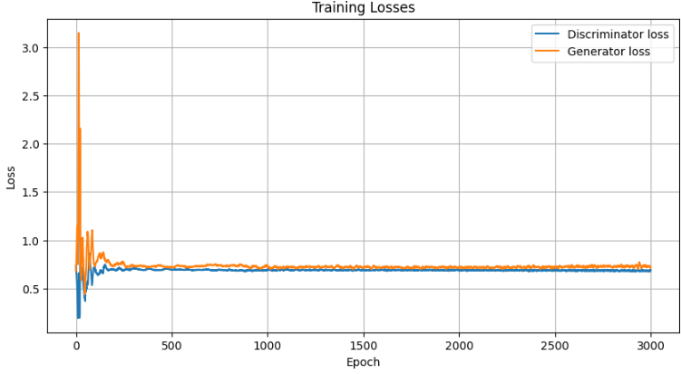
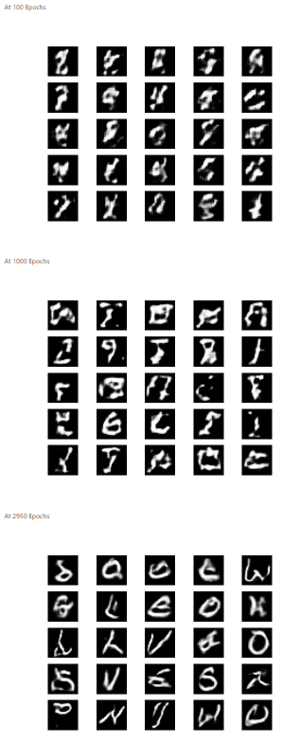
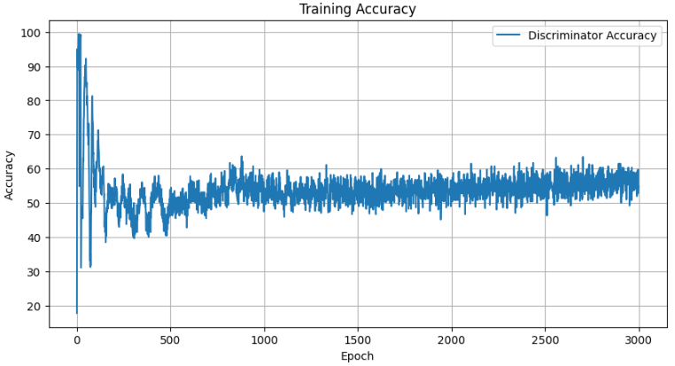
DCGAN (Using ReLU)
Using ReLU Evaluation

Slide 37
DCGAN (Adding More Dense Units to Generator)
What changed from the previous model
Dense units in the first Dense layer of the generator increased from 128 to 1500
Number of epochs increased from 3000 to 10000
Why did we increase the number of dense units for the generator
We increased the number of dense units for the generator to enhance its capacity to learn and represent complex patterns in the data. With more dense units, the generator can capture a greater variety of features and nuances, which is essential for producing high-quality, detailed images.
Why did we increase the number of epochs
From the previous models, we observed that 3000 epochs were insufficient for the generator to fully learn the underlying patterns in the data. By increasing the number of epochs to 10000, we aim to provide the model with more training time to refine its outputs and improve image quality. This extended training period allows the generator to better capture the complexities of the dataset, leading to more realistic and detailed images.

Slide 38
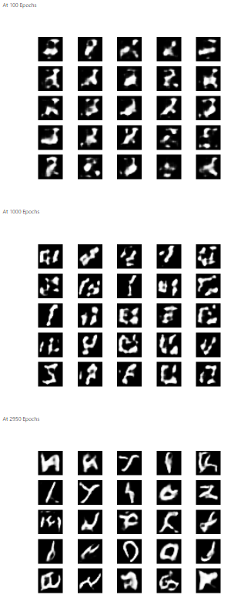
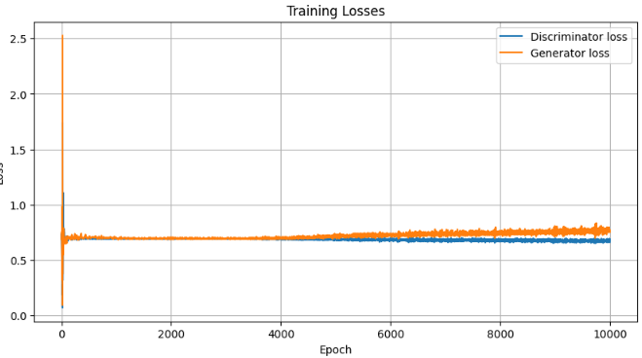
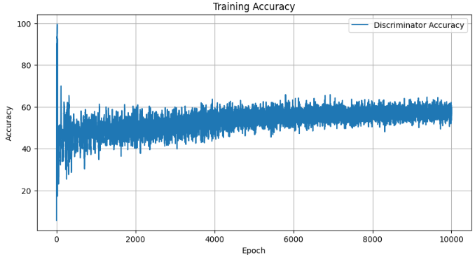
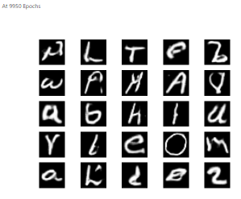
DCGAN (Adding More Dense Units to Generator)
Adding More Dense Units to Generator Evaluation

Slide 39
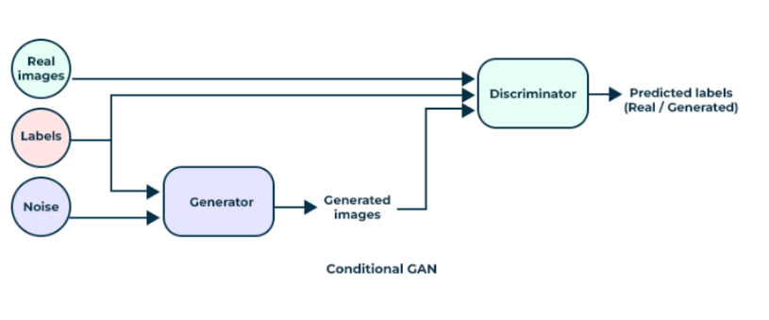
Conditional GAN (CGAN)
What is Conditional GAN
CGANs is a type of Generative Adversarial Network that adds additional information into both the generator and the discriminator to condition the generation process. This additional information can be any type of label or structured data such as class labels, images or other data that helps the generation process.
It allows the generator to create more controlled and contextually appropriate outputs by using the additional information given to it.
Difference between CGANs and DCGANs
CGANs uses additional information as conditions into the generation process while DCGANs focus on using convolutional networks for better performance in image data.
CGANs are used for tasks that need controlled generated based on the input conditions while DCGANs are used for generating high-quality, realistic images.
CGANs defining feature is the conditioning mechanism while DCGANs specifically use deep convolutional networks for both the generator and discriminator, emphasizing the architecture rather than conditioning.
How Conditional GAN Works
In a CGAN, both the generator and the discriminator receive additional information, such as class labels or attributes, which guide the image generation process. This allows the model to create images that not only resemble real data but also match specified conditions, providing greater control over the output.
The generator in a cGAN takes two inputs: random noise, typically sampled from a normal distribution, and a conditioning variable that represents the desired outcome, such as a class label. This generator learns to produce synthetic images that correspond to the given condition.
Similarly the discriminator also receives both real images and generated images, along with their respective conditions. Its role is to determine whether an image is real or fake, taking the condition into account, and it outputs a probability indicating how likely the image is to be real given that condition.

Slide 40
CGAN (Base)
Training Process of Conditional GAN
During each training iteration, the discriminator is trained using a mixed batch containing both real images from the training dataset and generated images produced by the generator, along with their corresponding condition labels. This mixed batch allows the discriminator to simultaneously evaluate and compare real and synthetic samples. After calculating the loss for both real and generated samples, the discriminator's weights are updated to improve its classification accuracy in distinguishing between authentic and generated images while considering the conditional inputs.
Next, the generator is trained by feeding it random noise and the conditional inputs, aiming to maximize the discriminator’s error on the generated images. To facilitate this process, it is common to freeze the weights of the discriminator while training the generator, preventing it from adapting too quickly and allowing the generator to learn more effectively from the feedback. Conversely, when the discriminator is being trained, the generator's weights are frozen. This alternating training helps stabilize the learning dynamics, ensuring that neither component overpowers the other.
Over multiple iterations, both networks improve, ultimately resulting in high-quality, class-specific image generation.

Slide 41



CGAN (Base)
Base Evaluation

Slide 42
CGAN (Increase the Number of Dense Units in the Generator)
What changed from the previous model
Dense units in the first Dense layer of the generator increased from 128 to 1500
Why did we increase the number of dense units for the generator
The first Dense layer of the generator is responsible for taking the input noise vector (latent space representation) and transforming it into a feature representation that can be further processed by subsequent layers to generate realistic images.
By increasing the number of units (neurons) in this layer, we increase the capacity of the generator to learn and capture more complex patterns and features from the input noise vector. This allows the generator to potentially model more intricate relationships and variations in the data distribution it aims to mimic.

Slide 43



CGAN (Increase the Number of Dense Units in the Generator)
Increase the Number of Dense Units in the Generator Evaluation

Slide 44
CGAN (Remove Batch Normalization Layer from the Generator)
What changed from the previous model
Batch normalization layer from the generator is removed
Number of epochs increased from 3000 to 10000
Why did we remove batch normalization layer from the generator
Batch normalization (BN) layers are typically used to stabilize and speed up the training of neural networks by normalizing activations and reducing internal covariate shift. In the context of GANs, the training dynamics can be quite sensitive, and batch normalization might interfere with the adversarial training process.
Why did we increase the number of epochs
From the previous models, we observed that 3000 epochs were insufficient for the generator to fully learn the underlying patterns in the data. By increasing the number of epochs to 10000, we aim to provide the model with more training time to refine its outputs and improve image quality. This extended training period allows the generator to better capture the complexities of the dataset, leading to more realistic and detailed images.

Slide 45




CGAN (Remove Batch Normalization Layer from the Generator)
Remove Batch Normalization Layer from the Generator Evaluation

Slide 46

Wasserstein GAN (WGAN)
What is Wasserstein GAN
Wasserstein Generative Adversarial Network (WGAN) is a variant of the standard GAN that aims to improve the stability of training and the quality of generated samples. WGANs use the Wasserstein distance (also known as Earth-Mover's distance) instead of the Jensen-Shannon (JS) divergence to measure the distance between the real and generated data distributions.
The generator's objective is to minimize the critic's score for the generated samples.
The critic's objective is to maximize the difference between its scores for real and generated samples.
Difference between WGAN and DCGAN
WGAN can use various architectures for the generator and discriminator, similar to DCGAN. However, it requires a different discriminator called a "critic" that does not output probabilities but rather real-valued scores.
WGAN uses the Wasserstein distance instead of the JS divergence.
WGAN improves training stability by clipping the weights of the critic to enforce the Lipschitz constraint, which is required for the Wasserstein distance to be valid.
Why Wasserstein Distance Could Be Better than JS Divergence
Gradient Issues: JS divergence can lead to vanishing gradients when the real and generated distributions do not overlap significantly. The Wasserstein distance, on the other hand, provides meaningful gradients even when the distributions are disjoint, allowing for more stable and continuous training.
Training Stability: The Wasserstein distance has better theoretical properties that contribute to more stable training dynamics. It provides a smoother and more informative measure of the distance between distributions, leading to more reliable updates to the generator.
Mode Collapse: WGANs are less prone to mode collapse, a common problem in standard GANs where the generator produces a limited variety of outputs. The Wasserstein distance helps in maintaining diverse generations by providing better feedback to the generator about the quality of the generated samples.

Slide 47
WGAN (Base)
Initialization and Model Setup
The WGAN class is initialized with parameters specific to the image data being used (28x28 pixels, single channel). The latent_dim parameter represents the dimensionality of the noise vector fed into the generator.
Key hyperparameters include the number of critic updates (n_critic) per generator update and the weight clipping value (clip_value) to enforce the Lipschitz constraint required for the Wasserstein distance.
Critic and Generator Models
The generator model starts with a dense layer, reshaping the noise input into a low-resolution image and progressively upsampling it through a series of convolutional and upsampling layers. Batch normalization and ReLU activations help stabilize the training.
The critic model uses convolutional layers with strides, LeakyReLU activations, dropout, and batch normalization. It reduces the input image to a single scalar output, indicating the "realness" of the image. The critic's loss function is the Wasserstein loss, which helps provide meaningful gradients even when the critic is far from optimal.
Training Loop
The training loop is designed to update the critic more frequently than the generator to ensure the critic remains accurate. For each epoch, a batch of real images is randomly sampled from the training data. Noise vectors are sampled from a normal distribution to generate fake images. The critic is then trained on both real and fake images, and its weights are clipped to enforce the Lipschitz constraint.
After updating the critic, the generator is trained to produce images that the critic would classify as real. Losses and accuracies for both models are recorded, and the Wasserstein distance is calculated to monitor the training process.

Slide 48



WGAN (Base) Evaluation
Training losses
Discriminator: The discriminator starts with a high training loss, indicating initial difficulty in distinguishing between real and generated images. This sharp drop in loss shows that the discriminator has significantly improved its ability to differentiate real from fake images. However, the subsequent increase before leveling off at a steady value of 0.00003 suggests that the discriminator has reached a point of equilibrium, where its performance has stabilized.
Generator: The generator begins with a low negative loss, reflecting poor initial sample quality. The sudden increase in loss indicates an improvement in performance, although the generator is still producing samples that are not ideal. The stabilization of the generator's loss at 0.00006 suggests that while the generator has achieved a relative stability, it is still generating samples that could be further refined.
Wasserstein Distance
The Wasserstein distance’s behavior indicates periods of instability followed by improved performance. A negative Wasserstein distance indicates successful training progress, as it shows that the generator is now producing samples that are closer to the real data distribution. The stabilization of the distance reflects that the generator and discriminator have reached a more balanced and effective state.
Generated Images
The generated images exhibit noticeable improvement compared to earlier epochs, showing that the model has made progress in learning the data distribution. However, these images still lack clear details and do not closely resemble the real samples. This suggests that while the generator is learning, it is not yet producing high-quality images.
The training dynamics indicate that both the generator and discriminator have reached a point of relative stability, as evidenced by the stabilization of their respective losses and the Wasserstein distance. However, the generated images still fall short in quality and detail. This mismatch suggests that there is room for further improvement in the generator's performance. To further improve the quality of the generated images, we plan to experiment with using Tanh activation function with normalization to the range of (-1,1) instead of sigmoid (0,1).
Notes:
Initial High Loss: The discriminator starts with a high training loss, indicating that it initially struggles to differentiate between real and generated images. This is typical as the discriminator is learning from the generator's initial poor-quality samples.

Slide 49
WGAN (Using Tanh activation with normalization to the range of (-1, 1))
Potential Improvements
Normalization to (-1, 1) and Tanh Activation
Normalizing the input data to the range of (-1, 1) and using Tanh activation functions can significantly benefit the learning process. Tanh activation, which outputs values in the range (-1, 1), aligns well with the normalization range, ensuring that the data is centered around zero.
This can help in maintaining a stable training process by avoiding issues like saturation and vanishing gradients, which are common with activations that output larger ranges.
Tanh activation function encourages stronger gradient signals compared to the sigmoid function, especially when inputs are centered around zero. This can lead to more efficient and faster convergence during training, ultimately improving the quality of the generated images.

Slide 50



WGAN (Using Tanh activation with normalization to the range of (-1, 1)) Evaluation
Training losses
The graph shows similar output as the base model but now that we changed to Tanh activation with normalization to (-1,1), the loss values has improved for both discriminator and generator. However, towards the end of the graph for generator, we can see that the losses start to decrease, which means that the generator may be overfitting or the model is not learning effectively anymore. This decrease in loss might suggest that the generator is producing samples that are too similar to each other, or that the discriminator is not providing useful feedback to the generator.
Wasserstein Distance
The Wasserstein distance’s behavior indicates periods of instability followed by improved performance. A negative Wasserstein distance indicates successful training progress, as it shows that the generator is now producing samples that are closer to the real data distribution. The stabilization of the distance reflects that the generator and discriminator have reached a more balanced and effective state. The trend over epoch shows that the Wasserstein distance is starting to increase which means that the generator's performance might be leveling off or improving at a slower rate.
Generated Images
The generated images shows improvement as the epoch increases. The generated images at 2950 epoch is more detailed and. This indicates that the generator has learned to capture finer features of the handwritten digits. There is clear improvement in overall quality which demonstrates the models ability to learn to generate images that are similar to the real dataset.
In summary, while the training losses and Wasserstein distance suggest that the model has reached a point of balance and is experiencing some stability issues, the generated images demonstrate that the generator has successfully improved its output quality. This combination of evaluations suggests that the GAN has made significant strides in learning to generate realistic images. To further improve the quality of the generated images, we plan to experiment with removing dropout and batch normalization layers from the critic.

Slide 51
WGAN (Removing Dropout and Batchnormalization Layers From the Critic)
Potential Improvements
Stability in Training:
Removing dropout and batch normalization layers can lead to more stable gradient updates. Dropout, while useful in regular neural networks to prevent overfitting, can introduce noise and instability in the gradients, which might disrupt the delicate balance required for effective WGAN training.
Preserving Gradient Flow:
Batch normalization can sometimes interfere with the learning process by altering the gradient flow through the network. Since WGANs rely on smooth and continuous updates to the weights to approximate the Wasserstein distance, ensuring an unimpeded gradient flow can lead to better convergence properties. By removing batch normalization, we allow the critic to provide more accurate gradient information to the generator.
Simplification of the Critic Architecture:
Simplifying the critic's architecture by removing dropout and batch normalization can lead to a more direct and effective learning process. This reduced complexity allows the critic to focus purely on distinguishing real and generated samples without the additional regularization constraints imposed by these layers.

Slide 52



WGAN (Removing Dropout and Batchnormalization Layers From the Critic) Evaluation
Training losses
The graph shows significant improvements as compared to the previous 2 graphs. The discriminator loss can be seen to be very close to 0 which means that the discriminator is effectively distinguishing between real and generated images. The generator loss can be seen to always be close to 0 but not as close as the discriminator’s loss, this means that while the generator is performing well and producing high-quality images, it has not yet fully achieved the level of success of the discriminator.
Wasserstein Distance
The Wasserstein distance’s behavior indicates periods of instability followed by improved performance. The initial spike to reach positive values means that the generator's initial attempts to produce realistic samples were met with significant challenges, causing the distance to temporarily increase. However, was the epoch increases, the Wasserstein distance drop back down to the negative values and is stable with negative values close to 0, which means that the generator has managed to improve over time and reduce the gap between the generated samples and the real data distribution. The negative values suggest that the training is progressing well, as a negative Wasserstein distance is a sign of effective learning and convergence towards the true data distribution.
Generated Images
The current model demonstrates significant improvements over the previous one, with better detail and more accurate representations of the handwritten digits. These advancements reflect the model’s enhanced performance and effective learning capabilities in generating realistic samples from the EMNIST dataset.
In summary, the combination of low training losses, stabilized Wasserstein distance, and high-quality generated images demonstrates that the current model represents a significant advancement over previous iterations. The model’s performance improvements across these metrics reflect its enhanced ability to generate realistic samples and its effective convergence towards the true data distribution. To further attempt to improve and trying something new for the generation of quality of the generated images, we plan to experiment using the current model and adding gradient penalty to it.

Slide 53
WGAN (with Gradient Penalty)
What is Gradient Penalty
Gradient penalty is a technique used in training Generative Adversarial Networks (GANs) to enforce the Lipschitz constraint more effectively than weight clipping. The primary goal of the gradient penalty is to ensure that the critic (discriminator) function satisfies the 1-Lipschitz condition, which is crucial for the theoretical properties and stability of Wasserstein GANs.
How WGAN with Gradient Penalty improves issues with weight clipping
Unlike weight clipping, which rigidly constrains the weights within a fixed range, gradient penalty dynamically enforces the Lipschitz constraint by penalizing deviations in the gradient norm. This ensures the gradient norm is close to 1, which is more theoretically sound and effective.
Weight clipping can overly constrain the model's capacity, limiting its ability to learn complex functions. Gradient penalty allows the model to use its full capacity, as the penalty is only applied to the gradients and not directly to the weights.
Gradient penalty mitigates the issues of vanishing and exploding gradients by ensuring that the gradients do not deviate significantly from a norm of 1. This leads to more stable training dynamics and reduces oscillations in the training process.
Potential Improvements
Addressing Mode Collapse
Traditional GANs often suffer from mode collapse, where the generator produces a limited variety of images. WGAN-GP addresses this issue by using the Wasserstein distance as a metric, which provides a smoother and more informative gradient for the generator. This helps in maintaining diversity in the generated images.
Improved Training Stability
The gradient penalty term in WGAN-GP ensures that the discriminator's gradients have unit norm, leading to more stable training and reducing the likelihood of mode collapse or vanishing gradients.
Enhanced Quality of Generated Images
By enforcing the Lipschitz constraint through gradient penalty, WGAN-GP improves the quality of the generated images. The generator receives more reliable and informative feedback from the discriminator, leading to higher-quality image generation.

Slide 54




WGAN (With Gradient Penalty) Evaluation
Training losses
d
Wasserstein Distance
d
Generated Images
c

Slide 55
07
Final Model

Slide 56
WGAN (With Gradient Penalty)
With Gradient Penalty Evaluation

Slide 57
Final conclusions
01 | 02 | 03 | 04 | 05
Lead generation fuels business growth and sales success | Nurturing leads is essential for building strong customer relationships | Understanding your target audience is the key to effective marketing | CRM integration streamlines lead management and boosts efficiency | Personalized communication enhances engagement and conversions
06 | 07 | 08 | 09 | 10
Continuous testing and optimization drive better marketing results | Quality content attracts and engages prospects throughout the funnel | Effective lead scoring helps prioritize and focus on high-value leads | Collaboration between sales and marketing teams maximizes conversions | Measuring key metrics provides insights for ongoing improvements

Slide 58
Thanks!
Do you have any questions?
youremail@freepik.com
+91 620 421 838
yourwebsite.com
Please keep this slide for attribution

